Slide 1
DSA
Training

Slide 2
Day-1

Slide 3
1 | Traversal | Arrays | Program for traversing array elements. (One dimensional, Two dimensional, multidimensional)
2 | Insertion | Arrays | Program to insert the given elements into an array.
3 | Insertion | Arrays | Program for insetion in the sorted array
4 | Deletion | Arrays | Program for delete the given elements into an array.
5 | Merging | Arrays | Program for merging two sorted arrays
6 | Set Operation | Arrays | Program for Set union
7 | Set Operation | Arrays | Program for Set Intersection
8 | Set Operation | Arrays | Program for Set Difference
9 | Set Operation | Arrays | Program for Set Symmetric Difference
10 | Address Computation | Arrays | Program for computation of address of given element in the one dimensional array and verification with the Physical Address
11 | Address Computation | Arrays | Program for computation of address of given element in the two dimensional array and verification with the Physical Address
12 | Address Computation | Arrays | Program for computation of address of given element in the three dimensional array and verification with the Physical Address
13 | Element analysis | Arrays | Program to find which element is repeated in the array and which is not
14 | Element analysis | Arrays | Program to find the missing element from the array
15 | Matrix | Arrays | Program for Matrix Addition
16 | Matrix | Arrays | Program for Matrix Subtraction
17 | Matrix | Arrays | Program for Matrix Multiplication
18 | Matrix | Arrays | Program for Matrix Transpose
19 | Matrix | Arrays | Program for finding Matrix Determinant
20 | Matrix | Arrays | Program for Matrix transposition without second matrix

Slide 4
Day1 | Control Structure | Write a program that takes a character as input and prints either 1, 0 or -1 according to the following rules. 1, if the character is an uppercase alphabet (A - Z) 0, if the character is a lowercase alphabet (a - z) -1, if the character is not an alphabet
Day1 | Control Structure | Write a program to calculate the total salary of a person. The user has to enter the basic salary (an integer) and the grade (an uppercase character), and depending upon which the total salary is calculated as - totalSalary = basic + hra + da + allow – pf where : hra = 20% of basic da = 50% of basic allow = 1700 if grade = ‘A’ allow = 1500 if grade = ‘B’ allow = 1300 if grade = ‘C' or any other character pf = 11% of basic. Round off the total salary and then print the integral part only.
Day1 | Control Structure | check whether a number entered by the user is even or odd.
Day1 | Control Structure | find the ASCII value of a character.
Day1 | Control Structure | find the largest number among the three numbers entered by the user.
Day1 | Control Structure | check whether an alphabet entered by the user is a vowel or a consonant.

Slide 5
Day1 | Control Structure | check whether the year entered by the user is a leap year or not.
Day1 | Control Structure | check whether three given integer values are in the range 20..50 inclusive. Return true if 1 or more of them are in the said range otherwise return false.
Day1 | Control Structure | check if two given non-negative integers have the same last digit.
Day1 | Control Structure | Write a program in C to read any day number in integer and display day name in the word
Day1 | Control Structure | Write a C program to check whether a triangle is Equilateral, Isosceles or Scalene.
Day1 | Control Structure | Write a program in C to read any Month Number in integer and display the number of days for this month
Day1 | Control Structure | Write a C program to read temperature in centigrade and display a suitable message according to temperature state below : Go to the editor Temp < 0 then Freezing weather Temp 0-10 then Very Cold weather Temp 10-20 then Cold weather Temp 20-30 then Normal in Temp Temp 30-40 then Its Hot Temp >=40 then Its Very Hot
Day1 | Control Structure | Write a C program to accept a coordinate point in a XY coordinate system and determine in which quadrant the coordinate point lies.

Slide 6

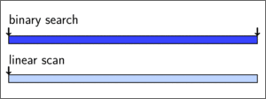
Basic Searching Methods
Search:
A search algorithm is a method of locating a specific item of information in a larger collection of data.
For searching the contents of an array:
Binary Search
Linear or Sequential Search

Slide 7
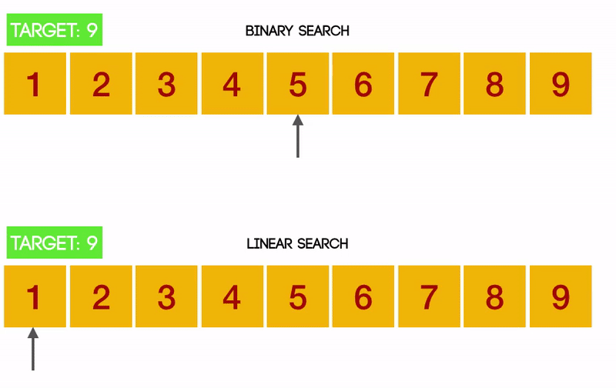

Slide 8

Sorting

Slide 9
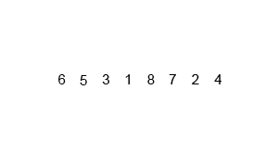
MERGE SORT
Merge sort is a sorting technique based on divide and conquer technique.
Merge sort first divides the array into equal halves and then combines them in a sorted manner.

Slide 10
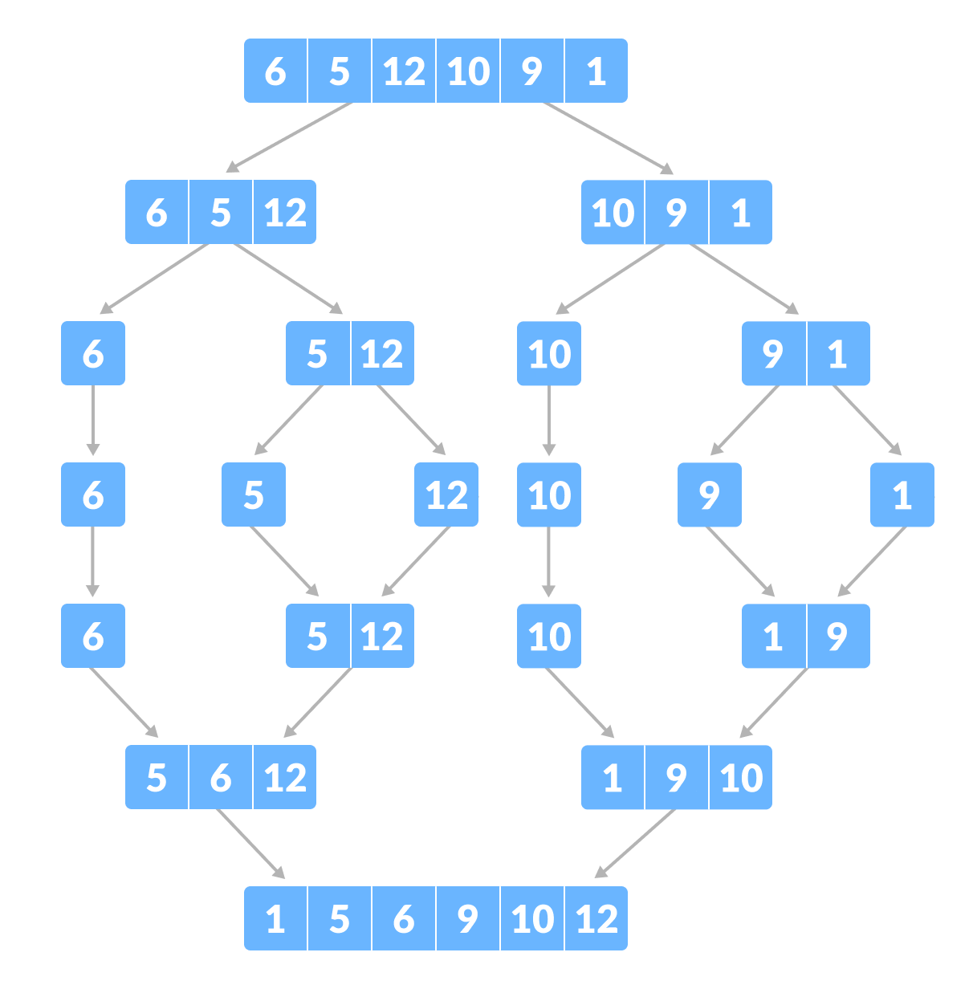
Merge Sort

Slide 11
Algorithm:MERGE_SORT(arr, beg, end)
Begin
if beg < end
set mid = (beg + end)/2
MERGE_SORT(arr, beg, mid)
MERGE_SORT(arr, mid + 1, end)
MERGE (arr, beg, mid, end)
end of if
END MERGE_SORT

Slide 12
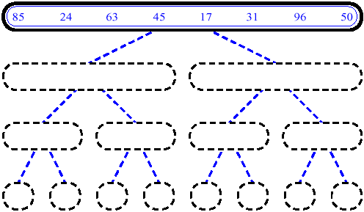
MERGE SORT

Slide 13
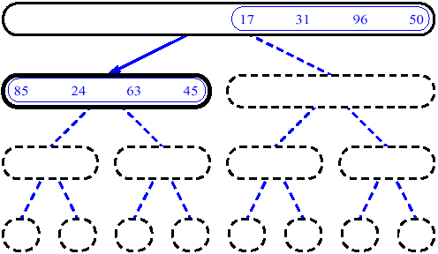
MERGE SORT

Slide 14
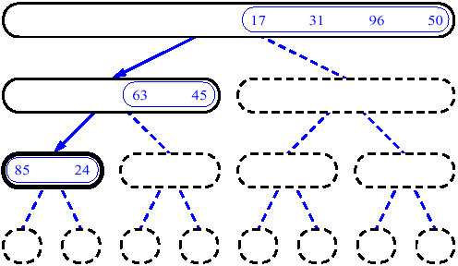
MERGE SORT

Slide 15
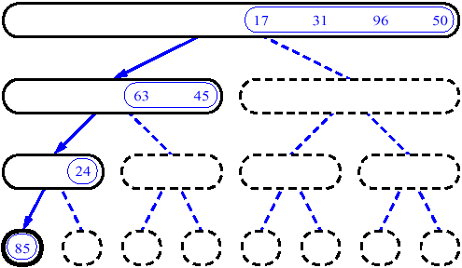
MERGE SORT

Slide 16
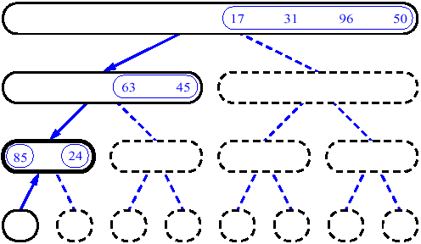
MERGE SORT

Slide 17
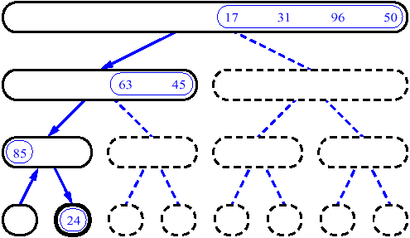
MERGE SORT

Slide 18
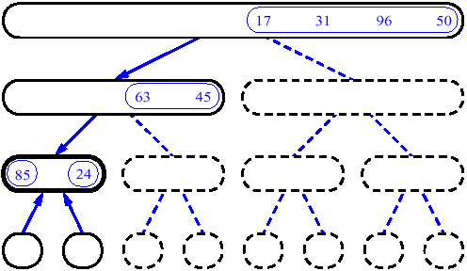
MERGE SORT

Slide 19
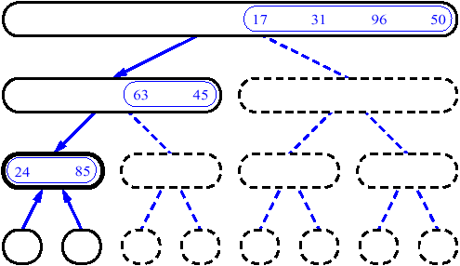
MERGE SORT

Slide 20
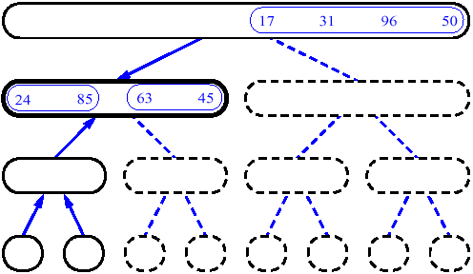
MERGE SORT

Slide 21
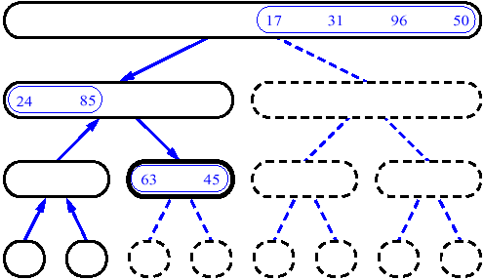
MERGE SORT

Slide 22
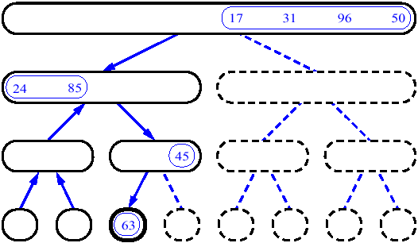
MERGE SORT

Slide 23
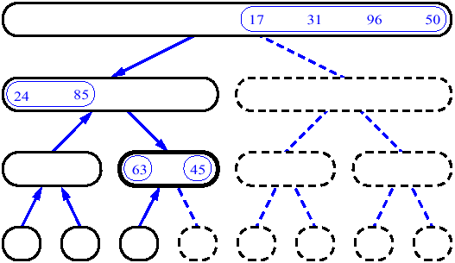
MERGE SORT

Slide 24
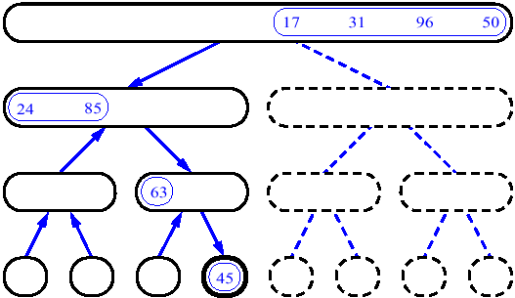
MERGE SORT

Slide 25
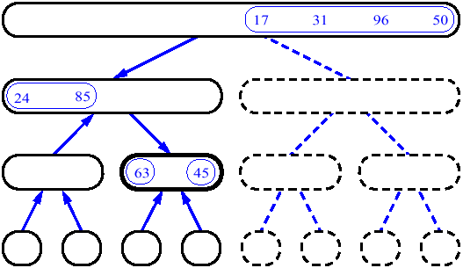
MERGE SORT

Slide 26
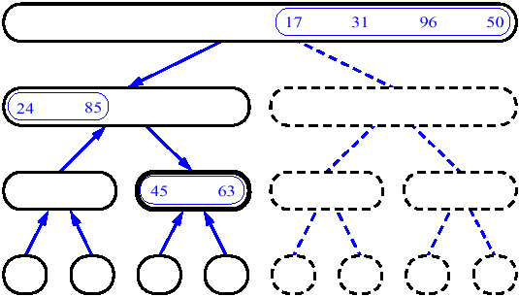
MERGE SORT

Slide 27
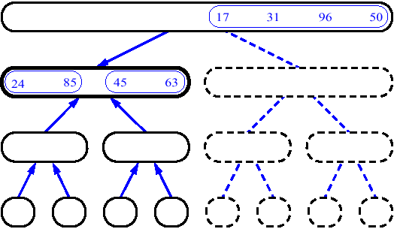
MERGE SORT

Slide 28
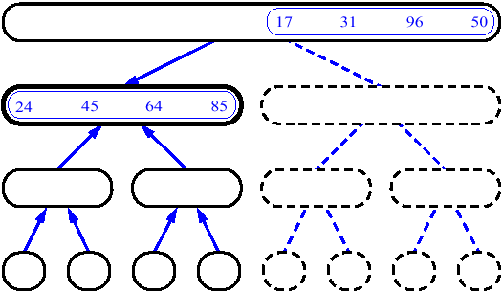
MERGE SORT

Slide 29
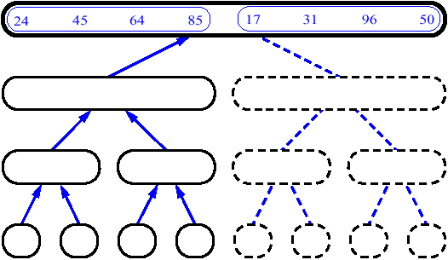
MERGE SORT

Slide 30
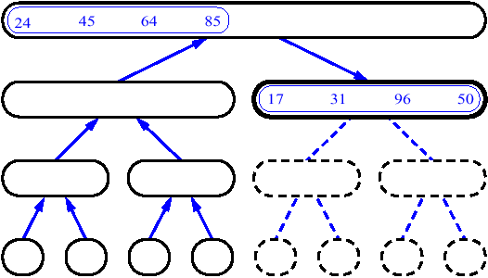
MERGE SORT

Slide 31
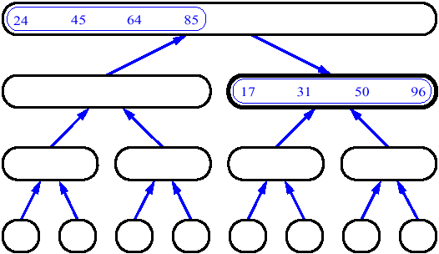
MERGE SORT

Slide 32
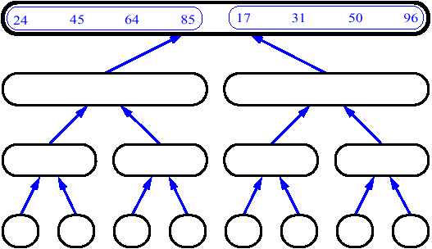
MERGE SORT

Slide 33
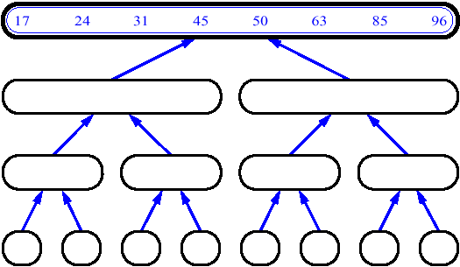
MERGE SORT

Slide 34
MERGE SORT
Steps to merge the list
14
23
45
98
6
33
42
67

Slide 35
MERGE SORT
Steps to merge the list
14
23
45
98
6
33
42
67
Merge

Slide 36
MERGE SORT
Steps to merge the list
14
23
45
98
6
33
42
67
6
Merge

Slide 37
MERGE SORT
Steps to merge the list
14
23
45
98
6
33
42
67
6
14
Merge

Slide 38
MERGE SORT
Steps to merge the list
14
23
45
98
6
33
42
67
6
14
23
Merge

Slide 39
MERGE SORT
Steps to merge the list
14
23
45
98
6
33
42
67
6
14
23
33
Merge

Slide 40
MERGE SORT
Steps to merge the list
14
23
45
98
6
33
42
67
6
14
23
33
42
Merge

Slide 41
MERGE SORT
Steps to merge the list
14
23
45
98
6
33
42
67
6
14
23
33
42
45
Merge

Slide 42
MERGE SORT
Steps to merge the list
14
23
45
98
6
33
42
67
6
14
23
33
42
45
67
Merge

Slide 43
MERGE SORT
Steps to merge the list
14
23
45
98
6
33
42
67
6
14
23
33
42
45
67
98
Merge

Slide 44
Algorithm:MERGE_SORT(arr, beg, end)
Begin
if beg < end
set mid = (beg + end)/2
MERGE_SORT(arr, beg, mid)
MERGE_SORT(arr, mid + 1, end)
MERGE (arr, beg, mid, end)
end of if
END MERGE_SORT

Slide 45
void merge(int a[], int beg, int mid, int end)
{
int i, j, k;
int n1 = mid - beg + 1;
int n2 = end - mid;
int LeftArray[n1], RightArray[n2];
/* copy data to temp arrays */
for (int i = 0; i < n1; i++)
LeftArray[i] = a[beg + i];
for (int j = 0; j < n2; j++)
RightArray[j] = a[mid + 1 + j];
i = 0, // first sub-array
j = 0; // second sub-array
k = beg; // merged sub-array
while (i < n1 && j < n2)
{
if(LeftArray[i] <= RightArray[j])
{
a[k] = LeftArray[i]; i++; }
else
{
a[k] = RightArray[j]; j++; }
k++;
}
while (i<n1)
{
a[k] = LeftArray[i]; i++; k++; }
while (j<n2)
{
a[k] = RightArray[j]; j++; k++; }
}

Slide 46
Applications
Merge Sort is useful for sorting linked lists in O (n Log n) time
Merge sort can be implemented without extra space for linked lists
Merge sort is used for counting inversions in a list
Merge sort is used in external sorting

Slide 47
Real-time application of Merge Sort
The e-commerce application
Have you ever noticed on any e-commerce website, they have this section of "You might like", they have maintained an array for all the user accounts and then whichever has the least number of inversion with your array of choices, they start recommending what they have bought or they like.
Some e-commerce website like policybazaar.com , trivago.com etc. use there search engine for collecting data from other website to provide minimum cost of booking hotel room or purchasing product

Slide 48

QUICK SORT
Separating the list into two parts. Initially, a pivot element is chosen by partitioning algorithm. The left part of the pivot holds the smaller values than the pivot, and right part holds the larger value.
After partitioning, each separate lists are partitioned using the same procedure.

Slide 49
QUICK SORT
Algorithm: quickSort(array, left, right)
Input − An array of data, and lower and upper bound of the array
Output − The sorted Array
Begin
if left < right then
q = partition(arraym left, right)
quickSort(array, left, q-1)
quickSort(array, q+1, right)
End

Slide 50
Some Important Concepts
Sorting

Slide 51
In-place Sorting and Not-in-place Sorting
Sorting algorithms may require some extra space for comparison and temporary storage of few data elements.
In-place Sorting
algorithms do not require any extra space and sorting is said to happen in-place, or for example, within the array itself. Like Bubble sort
Not-in-place sorting
Sorting algorithm requires space which is more than or equal to the elements being sorted. Sorting which uses equal or more space is called not-in-place sorting. For example, Merge-sort.

Slide 52
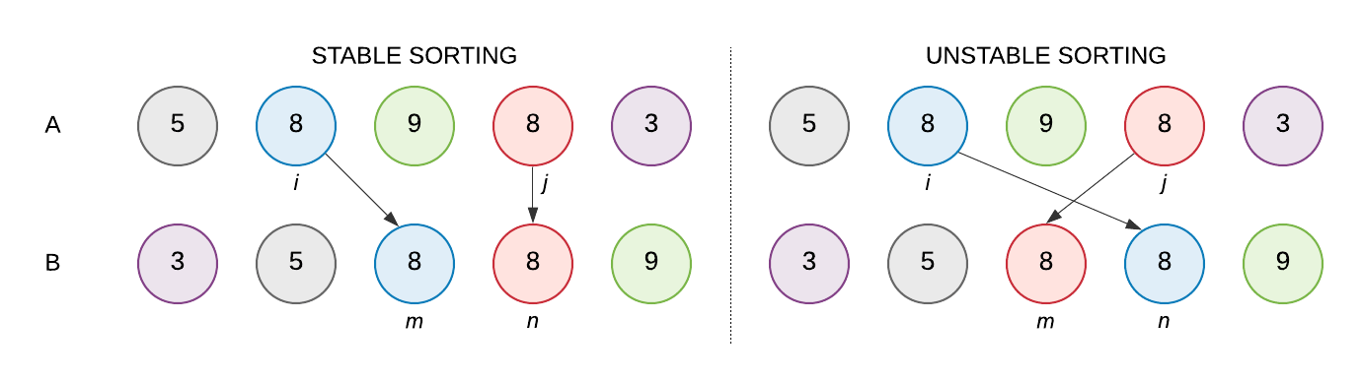
Stable Sort and Unstable Sort
Stable Sort
A sorting algorithm is said to be stable if the order of the same values in the output remains same as in input array.
Unstable Sort / Non Stable Sort
In an unstable sorting algorithm, the order of the same values is not necessarily preserved in the output array after sorting.

Slide 53
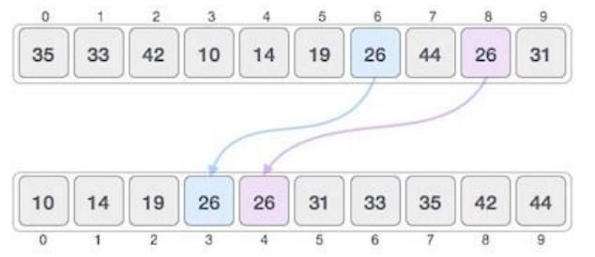
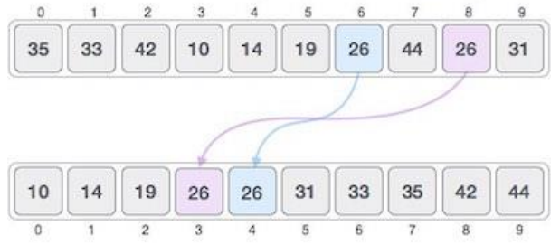
Stable Sort and Unstable Sort
Sorting algorithms which are considered stable are
Insertion sort
Merge Sort
Bubble Sort
Sorting algorithms which are not considered stable are
Selection sort
Shellsort
Quicksort
Heapsort

Slide 54
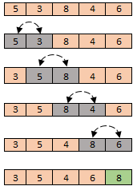
Sorting Categories
1. Comparison Based Sort
Only comparison of pairs of elements may be used to gain order information about a sequence.
Insertion, Selection, Bubble, Merge, Quick, Heap

Slide 55
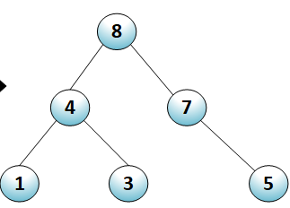
Sorting Categories
2. Decision Tree Based
Binary-tree abstraction for any comparison sort.
Represents comparisons made by a specific sorting algorithm on inputs of a given size.
1:2
≤
>
2:3
1:3
≤
≤
>
⟨1,2,3⟩
1:3
2:3

Slide 56
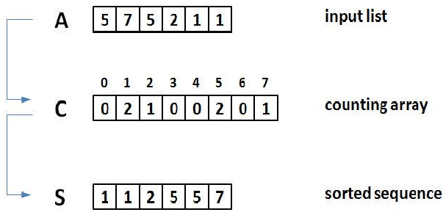
Sorting Categories
Non Comparison Sort
Depends on a key assumption: numbers to be sorted are integers in {0, 1, 2, …, k}.
Input: A[1..n] , where A[j] ∈ {0, 1, 2, …, k} for j = 1, 2, …, n. Array A and values n and k are given as parameters.
Auxiliary Storage: C[0..k]
Runs in linear time if k = O(n).
Like counting sort, Bucket sort.

Slide 57
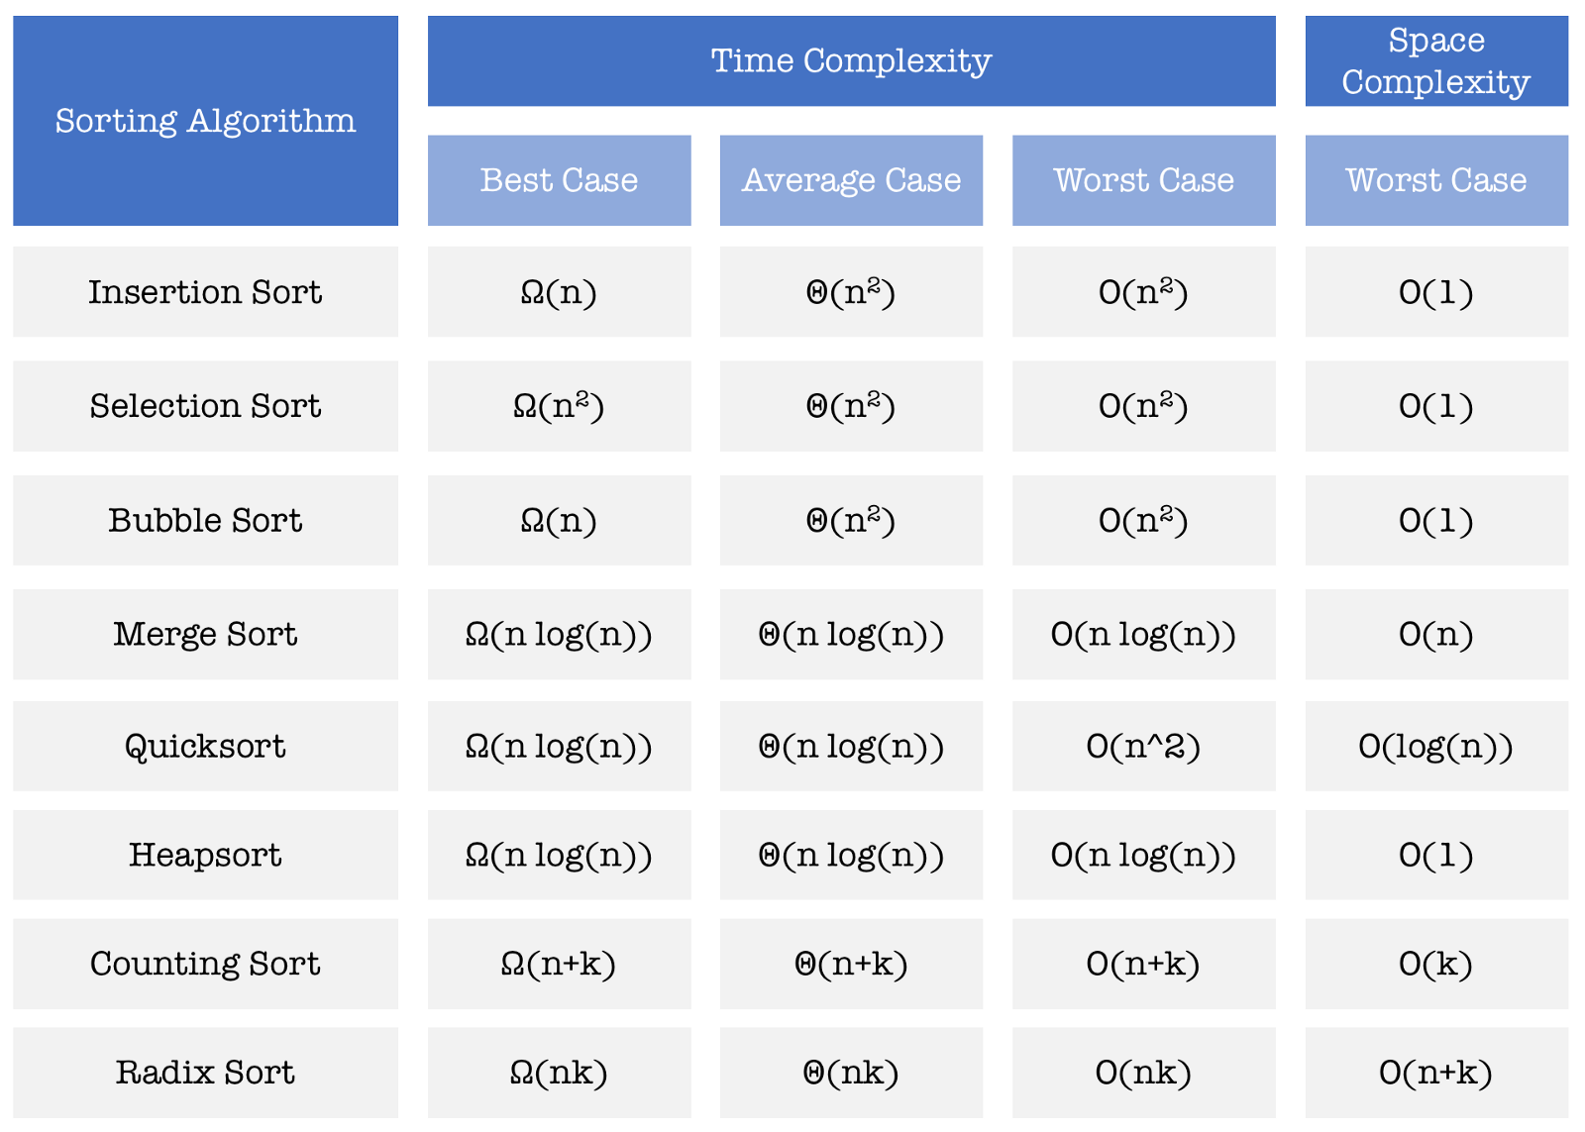

Slide 58
Sorting Based Problems
from
Leetcode and Hackerank

Slide 59

Median of Two Sorted Arrays
LEETCODE
Problem No. 4

Slide 60
Problem Statement
Given two sorted arrays nums1 and nums2
of size m and n respectively.
Return the median of the two sorted arrays.

Slide 61
Input: nums1 = [1,3], nums2 = [2]
Output: 2.00000
Explanation:
merged array = [1, 2, 3]
median is 2.

Slide 62
Median
To find the median, the data should be arranged in order from least to greatest.
If there is an even number of items in the data set, then the median is found by taking the mean (average) of the two middlemost numbers.

Slide 63
Can You Calculate ???
Input
1 | 3 | 5 | 6 | 7
2 | 4 | 10
1 | 2 | 3 | 4 | 5 | 6 | 7 | 10
Output
A 4
B 5
C 5.5
D 4.5

Slide 64
Can You Calculate ???
Input
1 | 3 | 3
2 | 2 | 2 | 8
1 | 2 | 2 | 2 | 3 | 3 | 8
Output
A 2
B 3
C 2.5
D 3.5

Slide 65
Algorithm says
Step 1: Initialization:
Two arrays, m & n
Step 2: Processing:
Merge elements of both arrays
Find median via middle number
Step 3: Output
Return median value

Slide 66
def findMedianSortedArrays(nums1 , nums2) :
nums3=(nums1 + nums2)
nums3.sort()
if len(nums3)%2==1: // ODD ELEMENTS
index=(len(nums3)//2)
return nums3[index]
else: // EVEN ELEMENTS
index=nums3[(len(nums3)//2)-1]+nums3[(len(nums3)//2)]
return float(index/2)
Input: nums1 = [1,2], nums2 = [3,4]
Output: 2.50000
Explanation: merged array = [1,2,3,4] and median is (2 + 3) / 2 = 2.5.

Slide 67
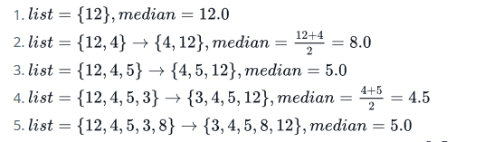
Skill Booster Exercise
Find the Running Median
Given an input stream of n integers, you must perform the following task for each ith integer:
Add the ith integer to a running list of integers.
Find the median of the updated list (i.e., for the first element through the ith element).
Print the list's updated median on a new line. The printed value must be a double-precision number scaled to decimal place (i.e., format).
Notes:
https://www.hackerrank.com/challenges/find-the-median/problem

Slide 68
Median of Two Sorted Arrays
Discussed Problem Was
LEETCODE
Problem No. 4

Slide 69
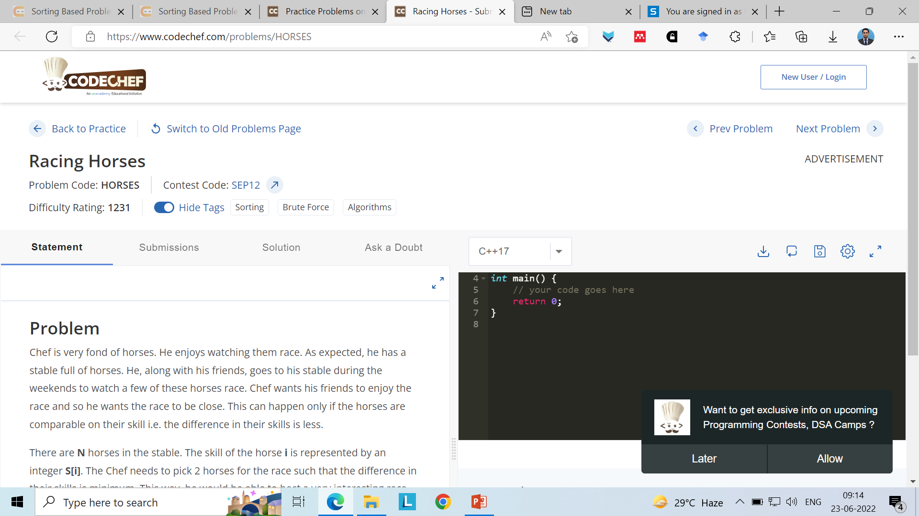
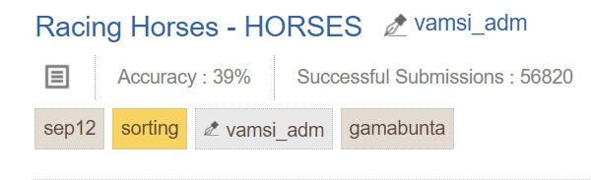

Slide 70
Racing Horses
Chef is very fond of horses. He enjoys watching them race. As expected, he has a stable full of horses. He, along with his friends, goes to his stable during the weekends to watch a few of these horses race. Chef wants his friends to enjoy the race and so he wants the race to be close. This can happen only if the horses are comparable on their skill i.e. the difference in their skills is less.
There are N horses in the stable. The skill of the horse i is represented by an integer S[i]. The Chef needs to pick 2 horses for the race such that the difference in their skills is minimum. This way, he would be able to host a very interesting race. Your task is to help him do this and report the minimum difference that is possible between 2 horses in the race.

Slide 71
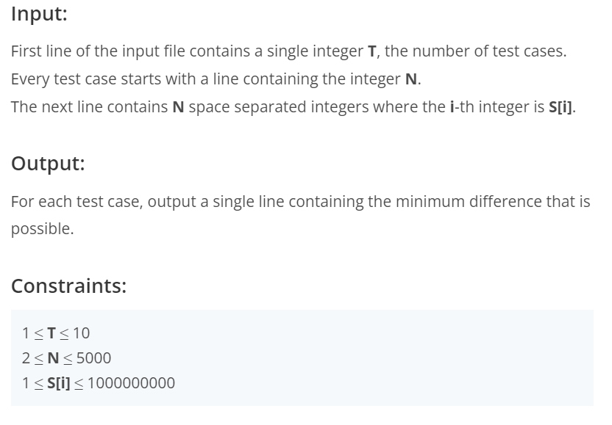
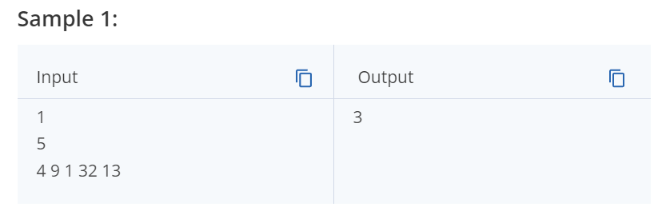
Racing Horses

Slide 72
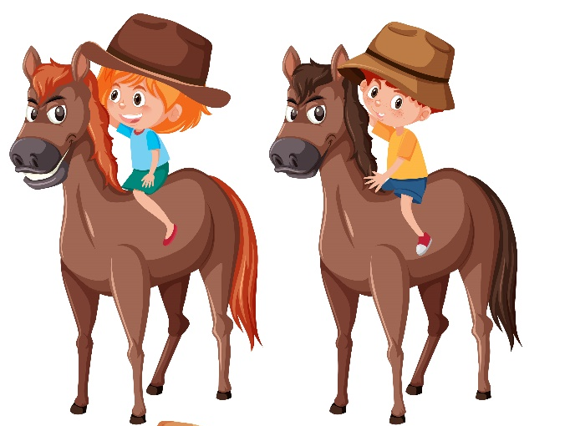
Algorithm says
Step 1: Initialization:
Array, horse skill
Step 2: Processing:
Sort the items
Find minimum difference in
two consecutive skill integers
Step 3: Output
Return difference value

Slide 73
Discussed Problem Was

Slide 74
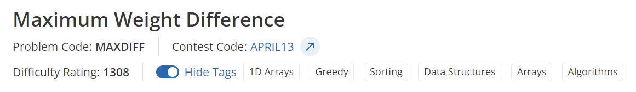
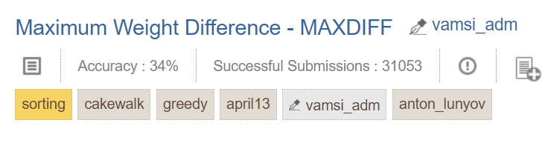

Slide 75
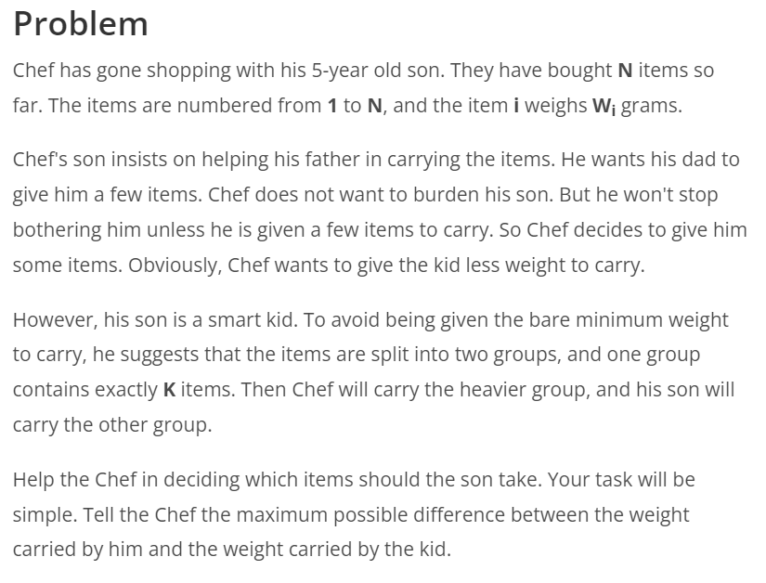
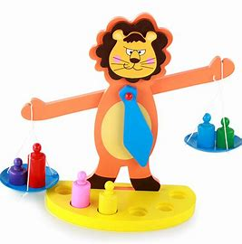
Maximum Weight Difference

Slide 76
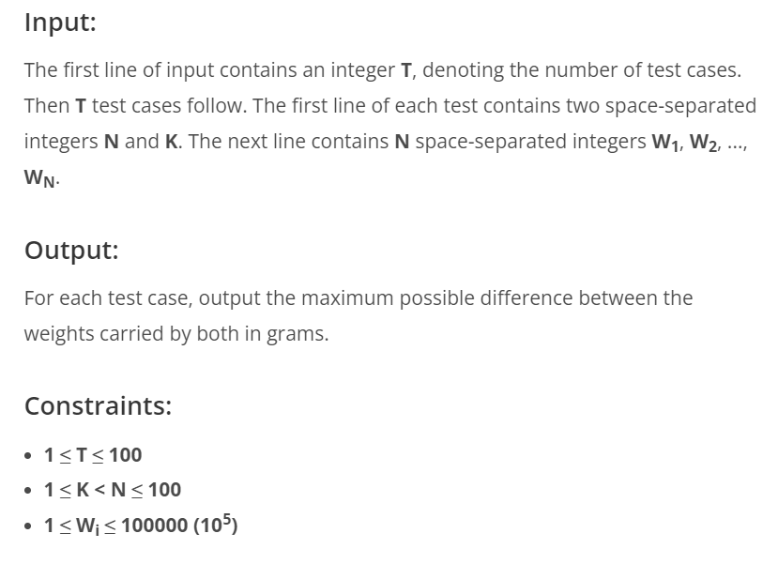
Sample Input
5 2
8 4 5 2 10
Output:
17

Slide 77
Algorithm says
Step 1: Initialization:
N: No. of toys K: toys to kid
Array, N with toys weight
Step 2: Processing:
Sort the items with weight
Find minimum weighted K toys
Calculate sum of K and N-k
Find difference
Step 3: Output
Return difference value
Sample Input
5 2
8 4 5 2 10
Output:
17

Slide 78
Discussed Problem Was

Slide 79
Problem Solving | 1D Array
Working with single array
Problem Title
Tempo Traveller

Slide 80
Problem Solving | 1D Array
In a tempo traveller, 10 persons are travelling with their luggage.
On a check post, the allowed weight is 3 tons. The weight of traveller is 1800 kgs and the luggage it carries is 400 kgs.
Now the weights of the persons are given in an array. To avoid over weight challan, the driver requested ‘n’ persons to cross the check post by walking. Find out the minimum value of n as per above scenario.
Note: Driver weight is 100 kgs. Driver can be considered as the 11th person.
Tempo Traveller

Slide 81
Problem Solving | 1D Array
Input Format:
An array of 10 persons weight
Output Format:
Number of persons; an integer number
Constraint:
Weight of a person is in the range from 10 to 200.
Fractional weight not allowed.
Tempo Traveller

Slide 82
Problem Solving | 1D Array
Sample Input 1 :
110 105 84 95 65 45 78 90 95 25
Sample Output 1 :
1
Tempo Traveller

Slide 83

Problem Solving | 1D Array
Working with single array
Problem Title
Nani House

Slide 84
Title: Nani’s house
Category: 1D array
Difficulty: moderate
Statement: A kid is going to his Nani house. He wants to carry some toys with him in a carry bag. But he can lift upto 5 kg weight in it. Find out the maximum number of toys he can go with, to his nani’s house.
Input Format: List of toy weight
Output Format: number of toys; an integer Number

Slide 85
Title: Nani’s house
Input Format: List of toy weight
Output Format: number of toys; an integer Number
Constraint: the number of toys, n, can be from 1 to 30. Weight of a toy is mentioned in grams only.
200 1800 1200 1500 500 800 4000
5
2000 3000 1500 1400 800 1200 600 2500
4
100 1010 1200 800 700 1500 600 2500 3000 8000 900
6
https://repl.it/@harshkhatter123/Nani-house#main.py

Slide 86

Try yourself

Slide 87
Searching Based Problems
from
Leetcode and Hackerank

Slide 88
Shuffle The Array
Leetcode :
Problem No. 1470
https://leetcode.com/problems/shuffle-the-array/

Slide 89
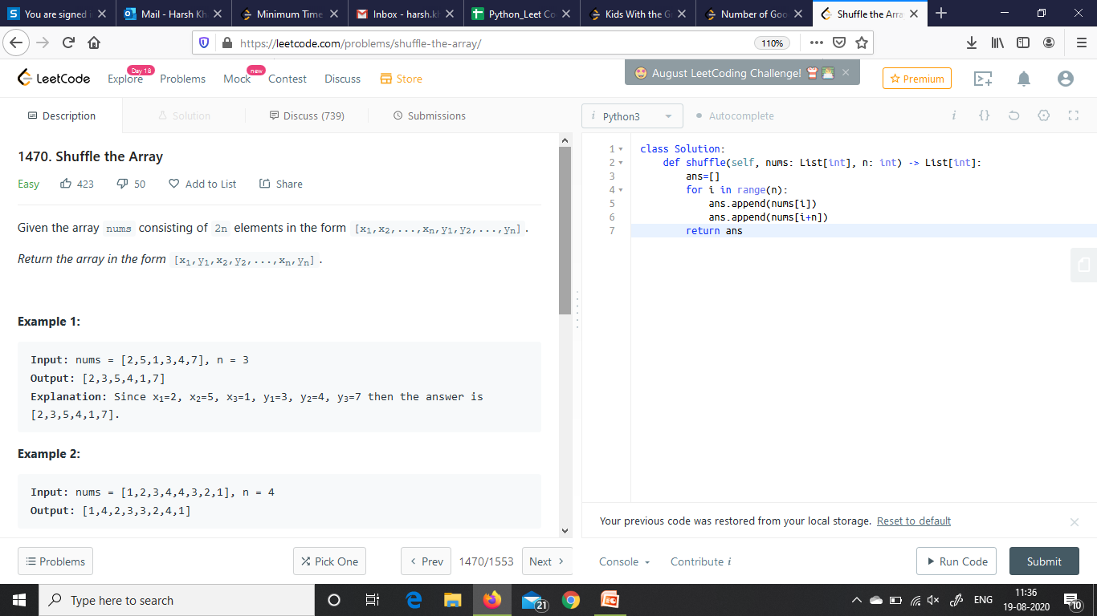
Problem Statement

Slide 90
Concept
Nums = [10, 20, 30, 40, 50, 60]
[10, 20, 30]
[40, 50, 60]
Output =
Initially, divide array in two ‘n’ size arrays

Slide 91
Concept
Nums = [10, 20, 30, 40, 50, 60]
[10, 20, 30]
[40, 50, 60]
Output =
10 | 40
First iteration: take first element from both

Slide 92
Concept
Nums = [10, 20, 30, 40, 50, 60]
[ , 20, 30]
[ , 50, 60]
Output =
10 | 40 | 20 | 50
Second iteration: take 2nd element from both

Slide 93
Concept
Nums = [10, 20, 30, 40, 50, 60]
[ , , 30]
[ , , 60]
Output =
10 | 40 | 20 | 50 | 30 | 60
Third iteration: take 3rd element from both

Slide 94
Pseudo Code
Step 1: Initialization:
N means ½ of array elements
If nums having 6 elements, then
N = ?
N = 6 / 2 = 3
Take input array nums and N
Step 2: Processing ???
6 ? 3 ? 2 ?

Slide 95
Pseudo Code: Approaches
Step 2: Process:
Arrange the existing array
Make necessary changes as i th index and
(i + n)th index
OR
Step 2: Process:
Take new array
One by one take element & store in new array
i th index and (i + n)th index

Slide 96
Python Code
def shuffle(self, nums):
# new array ans
ans=[]
# apply for loop for n iterations
for i in range(n):
ans.append(nums[i])
ans.append(nums[i+n])
# function returns some value
return ans
Initialization
Processing
Output

Slide 97
Shuffle The Array
Discussed Problem was
Leetcode
https://leetcode.com/problems/shuffle-the-array/

Slide 98

Kids With the Greatest Number of Candies
LEETCODE
Problem No. 1431

Slide 99
Problem Statement
Given the array candies and the integer extraCandies, where candies[i] represents the number of candies that the ith kid has.
For each kid check if there is a way to distribute extraCandies among the kids such that he or she can have the greatest number of candies among them. Notice that multiple kids can have the greatest number of candies.
Extra candies can’t be partially given to any kid. Compute the case when all extraCandies will be given to each kid.
6 | 3 | 5 | 2 | 1
4
Array candies
extraCandies

Slide 100
6 | 3 | 5 | 2 | 1
4
Array candies
extraCandies
Check for greatest
1 + 4 = 5
6 | 3 | 5 | 2 | 5
= False
2 + 4 = 6
6 | 3 | 5 | 6 | 1
= True
5 + 4 = 9
6 | 3 | 9 | 2 | 1
= True
3 + 4 = 7
6 | 7 | 5 | 2 | 1
= True
6 + 4 = 10
10 | 3 | 5 | 2 | 1
= True

Slide 101
Input
6 | 3 | 5 | 2 | 1
4
Array candies
extraCandies
Output
True | True | True | True | False
☺ That’s the work to do ☺

Slide 102
Can You Calculate ???
Input
2 | 3 | 5 | 1 | 3
3
Array candies
extraCandies
Output
A
B
C
D
False | False | True | False | False
False | True | True | False | False
True | True | False | True | False
True | True | True | False | True

Slide 103
Quiz
Q. 1
print(8<5)
8
5
True
False
Q.2
print(2*3>=6)
2
6
True
False

Slide 104
Algorithm says
Step 1: Initialization:
array candies and the integer extraCandies
Step 2: Processing
one by one calculate value for each kid
i value with extraCandies
Check the greatest
True / False
Step 3: Output
print the boolean value

Slide 105
To fetch boolean value
(candies + extra candies >= greatest value)
This will return either
True
False

Slide 106
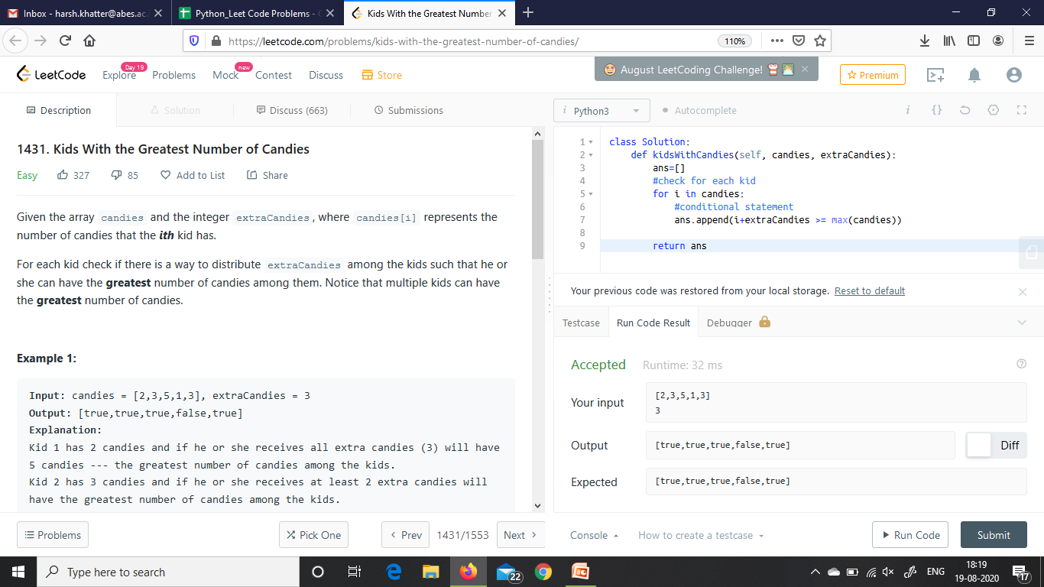
Approach 1
# Temporary List to store boolean values

Slide 107
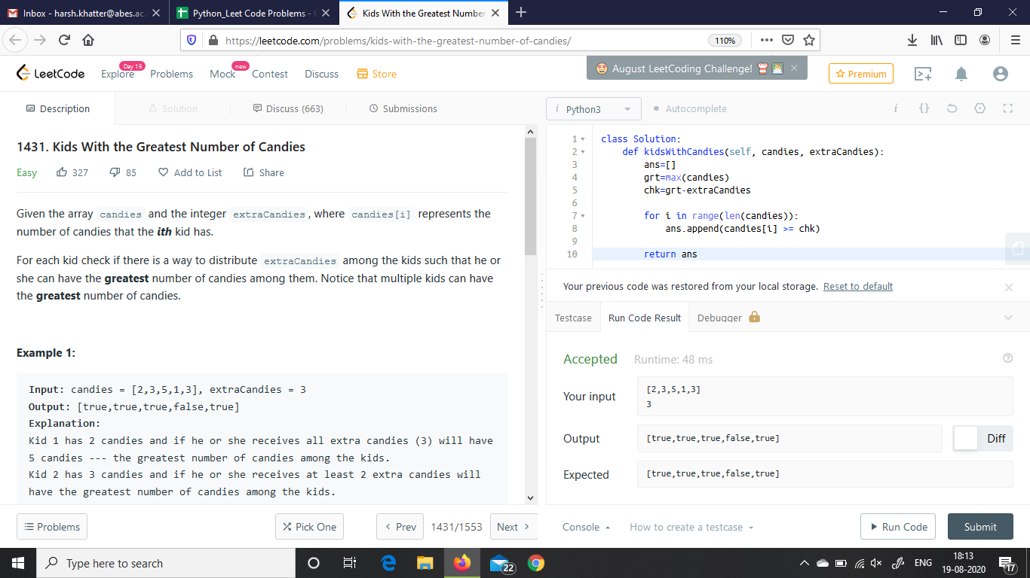
Approach 2

Slide 108
Kids With the Greatest Number of Candies
Discussed Problem was
LEETCODE
Problem No. 1431
Weblink @ https://leetcode.com/problems/kids-with-the-greatest-number-of-candies/

Slide 109
Problem Name How Many Numbers Are Smaller Than the Current Number
LEETCODE
Problem No. 1365

Slide 110
Step 1: Problem Statement
Given the array nums,
for each nums[i] find out how many numbers in the array are smaller than it.
That is, for each nums[i] you have to count the number of valid j's such that j != i and nums[j] < nums[i].
Return the answer in an array.

Slide 111
Step 2: Understanding the Problem
Input: nums = [8,1,2,2,3]
Output: [4,0,1,1,3]

Slide 112
Explanation
For nums[0]=8
there exist four smaller numbers than it (1, 2, 2 and 3).
For nums[1]=1
does not exist any smaller number than it.
For nums[2]=2
there exist one smaller number than it (1).
For nums[3]=2
there exist one smaller number than it (1).
For nums[4]=3
there exist three smaller numbers than it (1, 2 and 2).

Slide 113
Input
8 | 1 | 2 | 2 | 3
Output
4 | 0 | 1 | 1 | 3
☺ That’s the work to do ☺

Slide 114
Can You Calculate ???
Input
2 | 3 | 5 | 1 | 3
Output
A
B
C
D
1 | 2 | 3 | 0 | 2
1 | 2 | 3 | 4 | 5
1 | 2 | 4 | 1 | 2
1 | 2 | 4 | 0 | 2

Slide 115

Test Case 2
Input
6 | 5 | 4 | 8
Output
A
B
C
D
1 | 2 | 3 | 0
1 | 2 | 3 | 4
2 | 1 | 0 | 3
2 | 1 | 1 | 3

Slide 116
Constraint Quiz
What is the meaning of the constraints in terms of processing : j != i and nums[j] < nums[i].
A Integer values can’t be same & i is greater
B Indexes can’t be same
C Neither Indexes nor Values can’t be same
D Indexes can’t be same & i is greater

Slide 117
Step 3: Algorithm
Step 1: Initialization:
Step 2: Processing
Step 3: Output

Slide 118
1 def smallerNumbersThanCurrent(self, nums) :
2 ans = []
3 for i in range(len(nums)):
4 count =0
5 for j in range(len(nums)):
6 if nums[i]>nums[j] and i!=j:
7 count+=1
8 ans.append(count)
9 return ans
Input [8, 1, 2, 2, 3]
Output [4, 0, 1, 1, 3]

Slide 119
Test Case 3
Input
7 | 7 | 7 | 7
Output
A
B
C
D
3 | 3 | 3 | 3
1 | 1 | 1 | 1
0 | 0 | 0 | 0
4 | 4 | 4 | 4

Slide 120
How Many Numbers Are Smaller Than the Current Number
Discussed Problem was
LEETCODE
Problem No. 1365

Slide 121

Problem-1
Find the largest sub-array that the element satisfy the following condition x[i]=x[i-1]+x[i-2]
If more than one largest substring found, then the array which starts with the minimum elements should be selected.
If they are also same, then the array with minimum second element and so on.

Slide 122

Example 1
Input: arr =[2,3,5,7,8,11,12,19]
Output: [2,3,5,8]
Explanation: All sub-arrays are |2,3,5,8],[3,8,11],[5,7,12,19], among these, largest are [2,3,5,8] and [5,7,12,19].
So smaller first element is: [2,3,5,8]

Slide 123
Brute Force Approach
I- Initialize Len, Max_Len and sum=0, also declare 2 lists: arr2 and Result_Arr
II- Prepare a hashmap for the input array,
III- Add first two elements in a separate list ‘arr2’ and see if their sum is in hash.
IV- If found, add sum to ‘arr2’ and increment the Len by 1.
V- Recursively execute step II and III for next two elements from the hash.
VI- If sum of step-II not found in hash, then Compare if Max_Len<Len, update Max_Len by Len and copy ‘arr2’ into Result_Arr
VII- Take next two elements, and go to step-II
VIII- Return Result_Arr.

Slide 124
Efficient Approach
Prepare a HashMap and sort the input array
Prepare a DP matrix of size n+1 X n+1 with 1st row and column as 2 (as we may consider any two elements as a Fibonacci sequence of length 2)
Each cell of this DP array[i][j] will contain value equal to length of Fibonacci series ending with I,j .

Slide 125
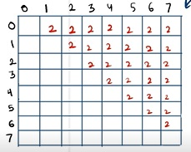
Example
Consider an array: 1,2,3,4,5,6,7,8
Initial DP matrix will be made as follows:

Slide 126
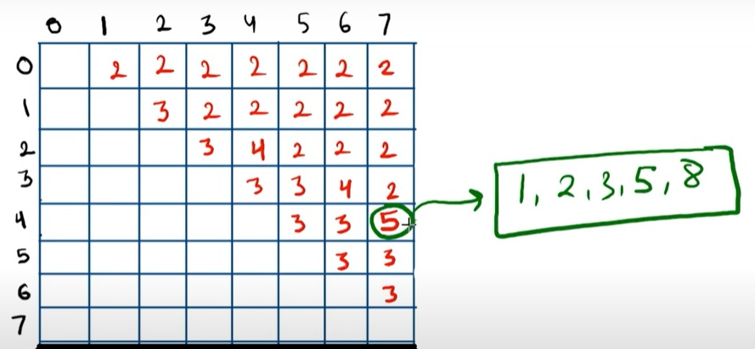
Finally after all updation, the matrix will ook like:

Slide 127
Problem-2
Number of odd sub arrays. Find the number of distinct subarrays in an array of position integers such that the sum of the subarray is an odd integer, two subarrays are considered different if they either start or end at different index.
Since the answer can be very large, return it modulo 10⁹ + 7.

Slide 128
Example 1
Input: arr = [1,3,5]
Output: 4
Explanation: All subarrays are [[1],[1,3],[1,3,5],[3],[3,5],[5]] All sub-arrays sum are [1,4,9,3,8,5]. Odd sums are [1,9,3,5] so the answer is 4.

Slide 129
Example 2
Input: arr = [2,4,6]
Output: 0
Explanation: All subarrays are [[2],[2,4],[2,4,6],[4],[4,6],[6]] All sub-arrays sum are [2,6,12,4,10,6]. All sub-arrays have even sum and the answer is 0.

Slide 130
Brute Force Approach
With this approach we can simply check whether the sum of elements in all subarrays is even or odd,
If it is even we will reject that subarray and will count subarrays with sum odd,
It is not an efficient approach as complexity of this approach is O(n²).

Slide 131
Efficient Approach
We get odd sum when we add an even number with an odd number.
We will do cumulative sum on the array O(n)
If the SUM is EVEN: add 1 to even count
If the SUM is ODD: add 1 to odd count and RESULT (as it will contribute in total number of odd sum sub-arrays). Also add even count to RESULT (as this odd along with all sum sub-arrays will also contribute in total number of odd sum sub arrays)

Slide 132
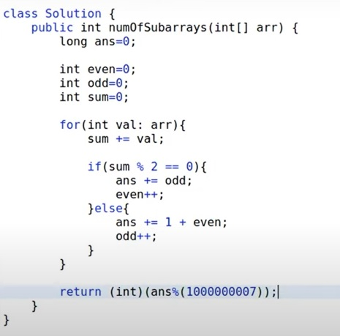
Code

